Slide 1


MIAD
Maestría
en Inteligencia Analítica de Datos

Slide 2




MIAD
SyPhone
Maestría
en Inteligencia Analítica de Datos
Sesión sincrónica
Ejercicio semana 1

Slide 3



SyPhone is a cell phone company that sells cell phone contracts to small to medium-sized companies. SyPhone finds itself in a highly competitive B2B market and the customer base is very sensitive to price, but only if service quality is high. Also, customer switching is a possibility when contracts are about to expire.
SyPhone needs to understand the profitability of its customers before generating a renewal bid for them. For new customers, SyPhone needs to understand their potential profitability before offering them a contract because, historically, SyPhone has offered various discount rates to prospective customers.
These case data may be used to explore whether offering large discounts is profitable for the company in the long term, and involves an analysis of the appropriate discount factors to apply to future revenue.
SyPhone customers may be grouped into two segments: - Large accounts represent contracts that cover between 100 and 500 cell phones. - Small accounts represent contracts that cover between 5 and 100 cell phones.
When negotiating contracts, some customers receive bigger discounts than others. For simplicity, they may be grouped into two subgroups: - No rebate customers pay $100 per month per user. - Rebate customers pay about $80 per month per user for the same service.
The data set that you will need to evaluate the SyPhone situation and develop appropriate recommendations follows:

Slide 4
*Segment count, gross margins and merket/next period costs at the start of the first period
*Probabilities for customers to move from one segment (left colum) to another (top row)at each period.Each row must sum to 100.

Slide 5
Exercises
Using the Enginius CLV model and a discount factor of 10%, answer the following questions:
Question 1
What is the lifetime value of a typical customer in each of the four segments, in current dollar values? Compare these figures to the “Gross margin” figures in the original spreadsheet. What can you learn from this comparison?

Slide 6
R. Though customers in the large account segment that do not negotiate a rebate generate gross margins 75% higher than those that do negotiate a rebate, the lifetime values of these two segments do not have the same relationship. Likewise, for small accounts, both segments indicate a lifetime value that differs from the gross margins would suggest. The reason for these results is that customers who obtain rebates tend to stay longer with the company, so the loss in gross margin in the short term is partly (or fully) compensated for by the resulting longer-term commercial relationship.

Slide 7
Question 2
Of the 15,000 customers SyPhone has today, how many will still be SyPhone customers in five years? What is the overall churn rate after five years? Answer the same questions, segment per segment. Top management has decided that a 10% discount factor is way too small. The environment is highly competitive and rapidly evolving, with new technologies emerging on a regular basis. In such environments, current technologies can become obsolete rapidly. To reflect the uncertainty associated with future revenues, the top management of SyPhone has asked you to rerun the analysis with a discount factor of 35%.

Slide 8
R. As of today, SyPhone has 15,000 active accounts. Five years from now, 11,793 will have left the company (a 78.62% churn rate), and 3,208 will remain active. This result highlights the crucial need for the company to acquire a regular flow of new accounts every year to remain profitable.

Slide 9
The second part of the question deals with the churn rate per segment. These churn rates cannot be inferred from the table. Although in five years, the company would still have 46 large accounts without rebates, that does not mean that the remaining 454 accounts have switched to competitors. Many of them may have renegotiated their contracts, which place them in the “large accounts (rebate)” segment.

Slide 10
Question 3
With a discount factor of 35%, reconsider Question 1. What changes do you notice, in both absolute and relative terms? In terms of customer value, what is the consequence of focusing on the short term?
Finally, the sales manager of SyPhone, Nadia Morel, has the following concern: Although she is comfortable that the lifetime value you have computed takes into account the revenues and costs of a customer once that customer has been acquired, she feels strongly that you have overlooked many other factors, such as the costs of acquiring an account (e.g., sales representatives, advertising, trade shows, promotions) and the fixed costs incurred once an account is acquired (e.g., setting up and configuring the server and material, managing the transition).

Slide 11
Here are some figures Morel suggests:
✓ Pre-sales costs are about $7,000 for a large prospective account and $1,500 for a small prospective account. These figures include such costs as sales representative efforts and promotions, which are incurred in the process of trying to acquire a new account, whether successful or not.
✓ 20% of the proposals to large accounts translate into signing a new customer. When a large discount is offered, this ratio goes up to 35%. For small accounts, the win rates are 15% (without rebate) and 40% (with rebate).
✓ The fixed costs associated with winning a new customer are important. It costs about $20,000 for SyPhone to set up a large account. These are one-time, internal costs and are not billed to the client, but they will be recouped over the years. To set up a smaller account costs much less, about $3,000.

Slide 12
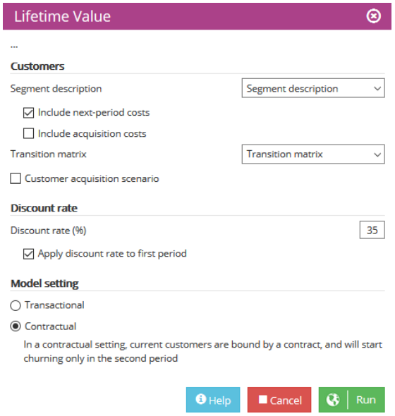
R. Changing the discount factor from 10% to 35% has several important effects on the CLV computations.

Slide 13
The change in the discount factor modifies the way the company values future revenues, such that more distant revenues are more heavily discounted as a result of market and technological uncertainties. “Large accounts were worth $118.5K before, and now they are worth $77.3K. Where did the revenues go?” Revenues are still there, intact, but those revenues that occur in the distant future are much more heavily discounted (less valued) by the firm.
Therefore, segments with higher short-term revenues (without rebate) are worth much more (proportionally) than are those segments with a longer investment horizon for the firm (with rebates and with lower churn rates).

Slide 14
Question 4
Build an Excel spreadsheet to estimate how much a prospective customer is worth, depending on whether that customer is offered a rebate. What do you learn from the updated spreadsheet? Explain the logic behind your findings and conclusions. Based on these results, what sales and marketing strategies would you recommend for SyPhone?

Slide 15
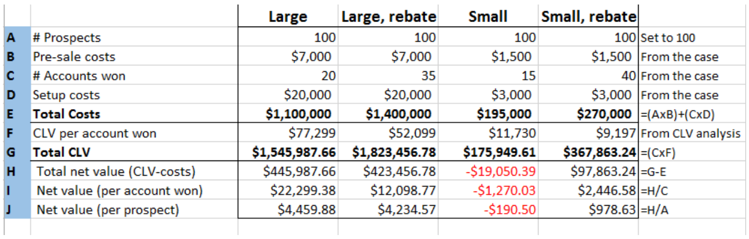
R.

Slide 16
This reveals, it is not profitable to target small accounts without offering them substantial rebates. Presales and setup costs are such that the company needs to keep acquired customers for several years before it recoups its initial investment. But not offering customers substantial rebates results in a high churn rate, which means they switch to competitors before those initial costs are recovered.
The same logic holds true for larger accounts. Thanks to a higher win rate associated with large rebates, the net value of prospects who receive rebates is reasonably close to the net value of those who are not offered a rebate.

Slide 17
CLV is more than just a metric. It is a way to allocate scarce marketing resources toward customers who are likely.
Companies face real challenges when attempting to implement CLV models. Part of that challenge is measuring customer lifetime value with any degree of confidence, especially at the level of each individual customer. In many large companies, organizational and management procedures prevent the precise measurement of CLV, especially when the same customer purchases many different products and services from different divisions of the company. Fortunately, the implementation of CRM systems now enables even large companies to track customers’ purchases across divisions.

Slide 18


Marketing
Analytics
MIAD
Maestría
en Inteligencia Analítica de Datos

